Slide 1
Airline Reservation System
Varshitha Chennamsetti (vc2209)
Dharu Piraba Muguntharaman (dm5596)

Slide 2
INTRODUCTION
Airline Reservation System is a development of a general flight booking website.
It contains information like flight schedules, routes, prices of tickets etc. The main idea of this project is to implement an online reservation system that could allow customers to book flights with ease.
The system displays the available flights and enables you to buy tickets.
There are many airlines, routes and passengers with which our application would be useful to keep track of the Airline information and do analysis on it.

Slide 3
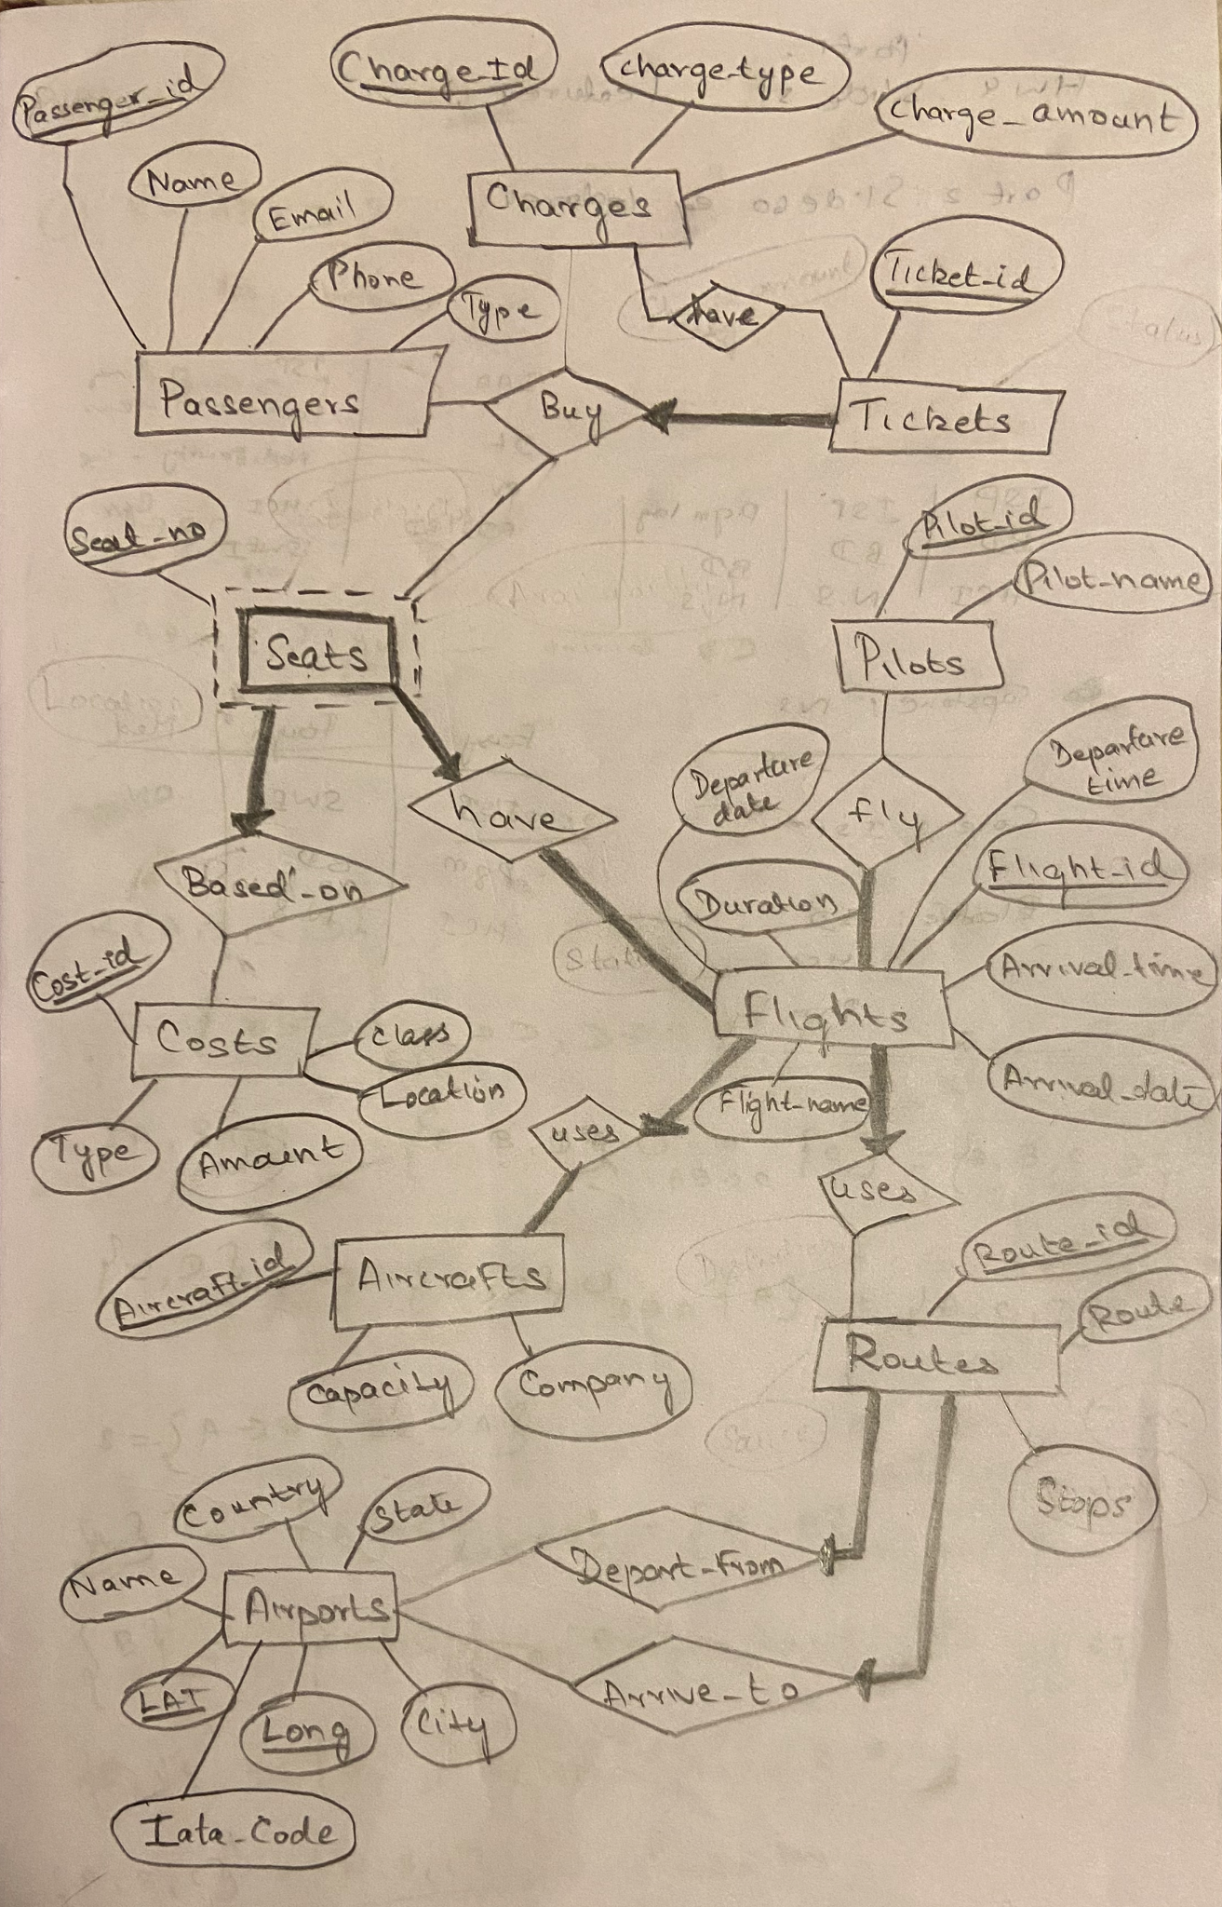
ER MODEL

Slide 4
Data Population
Data Collection
Most of the data was used from datasets found online such as Kaggle or Government websites.
Data Cleaning
Manually cleaned the dataset to remove any unnecessary columns or missing data.
The collected dataset had too many rows, they were mostly deleted to work with smaller amount of data.
Data Creation
There was some information like Passengers, Tickets, Seats, Costs, Charges, Pilots that needed realistic information.
Used online references to understand and create that data manually.

Slide 5
Queries and Results
See the Flight Schedule and Estimated costs
Statistical Descriptions such as min, max of costs, capacity of flights and number of stops with respect to a flight schedule, source and destination.
Data Analysis type questions like which flight, seat location and seat class has the most number of ticket cancellations from passengers?
Found that economy class had the most number of any type of extra charges which could be because usually in any flight there are lesser business class passengers then economy.
Recommendation lists - flights based on number of bookings, affordability and a combination of both.

Slide 6
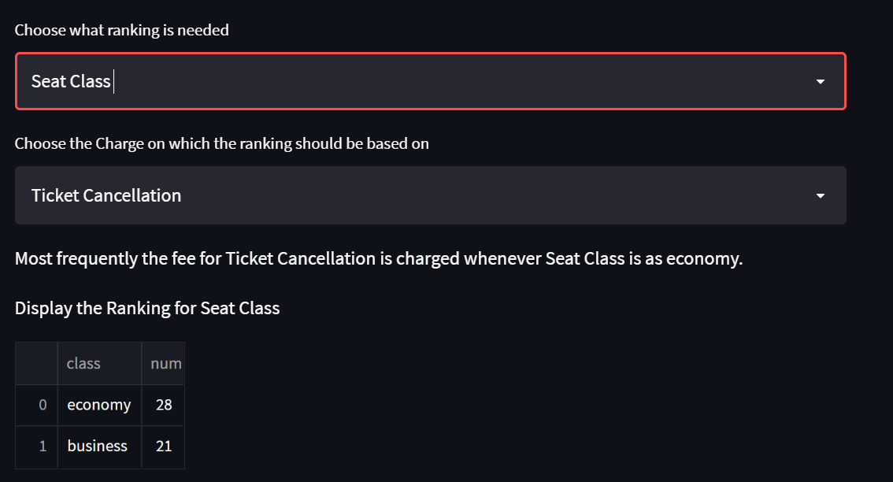

Slide 7
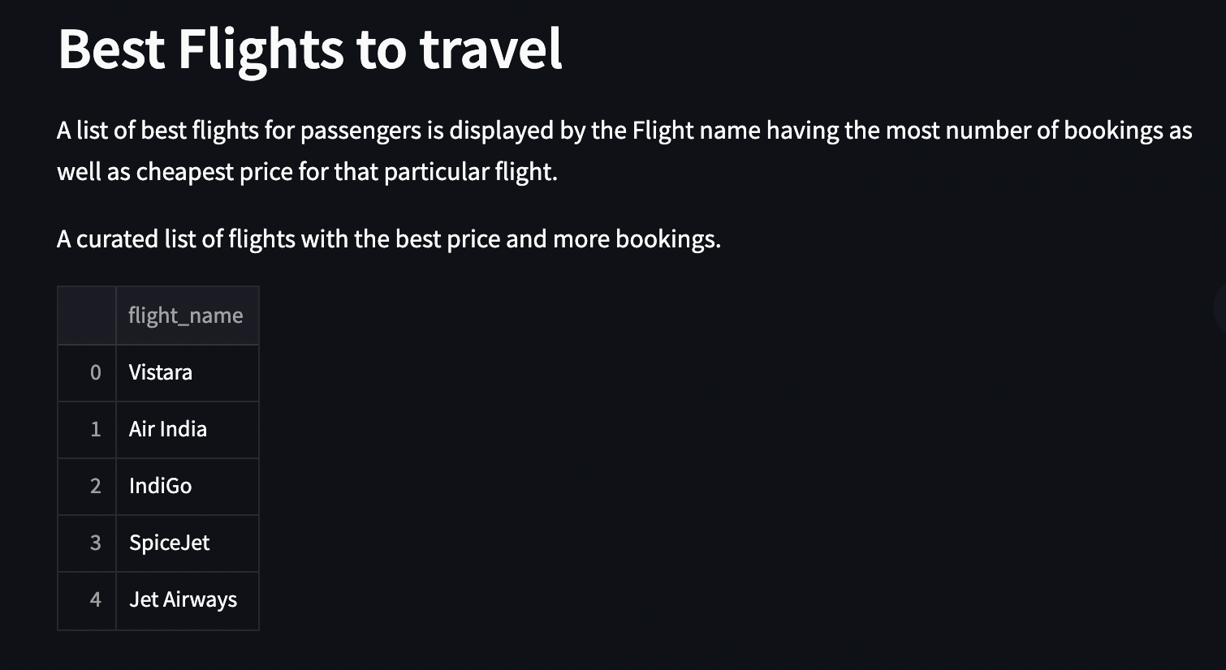
RECOMMENDATION LISTS BASED ON POPULARITY AND AFFORDABILITY

Slide 8
THANK YOU

